Slide 1
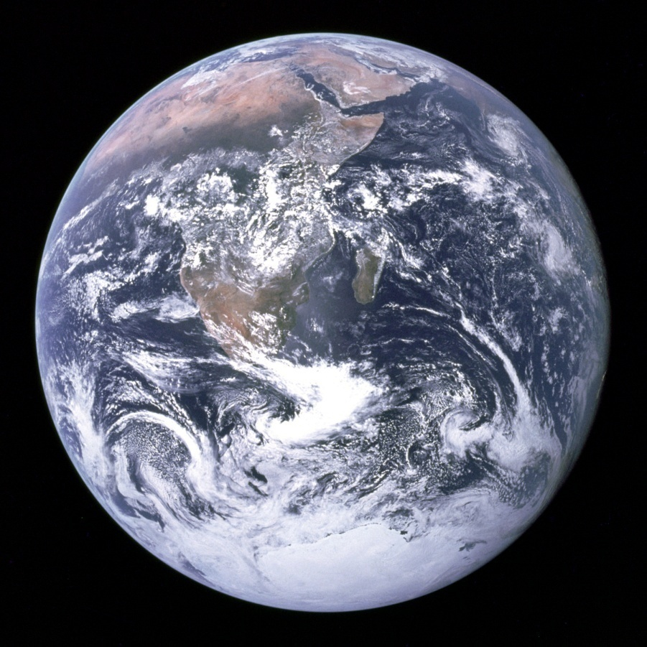
Renewable vs. non-renewable
Renewable = replenished on human timescales
Non-renewable = formed over geologic (VERY long) timescales. For our purposes, there is a finite quantity available
Notes:
BRAINSTORM

Slide 2
Food
What other Earth resources are required to produce food for a large population? (come up with as many as you can)

Slide 3
Human use of resources
i.e. WHAT we use, HOW MUCH we use, HOW we use them
Depend on several factors, e.g:
→ Societal norms
→ Cultural attitudes
→ POPULATION
Notes:
HOPEFULLY, the first two are informed by our understanding of the availability of and environmental impacts of that use on our world… but it isn’t always
Assuming those first two are hard to predict and so variable across the world – lets explore the third, population

Slide 4
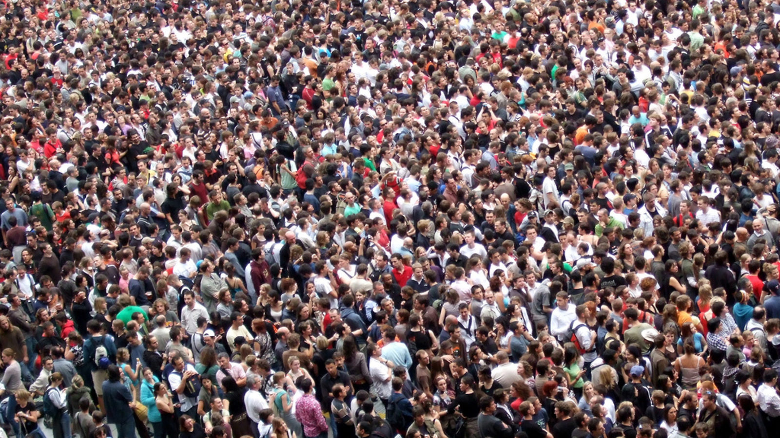
Earth’s POPULATION
Notes:
All materials needed for modern society are derived from Earth – absolutely everything you own! We don’t often think of our possessions that way.
1) Our resource needs can’t be considered individually – our use of any one resource is complexly linked to a host of other resources…

Slide 5
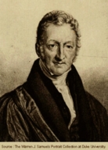
Why Population is so important
Thomas Malthus (1798)
Organism populations increase exponentially, whereas the “environment” is “fixed” (actually decreases).
Notes:
English cleric and scholar at turn of the 19th century. In his 1798 book An Essay on the Principle of Population, Malthus observed that an increase in a nation's food production improved the well-being of the populace, but the improvement was temporary because it led to population growth, which in turn restored the original per capita production level. In other words, mankind had a propensity to utilize abundance for population growth rather than for maintaining a high standard of living, a view that has become known as the "Malthusian trap"

Slide 6
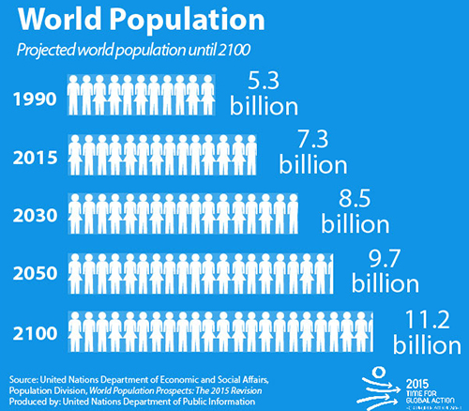
Population
How has it changed through time?
Where do we stand now?
Predictions for future

Slide 7
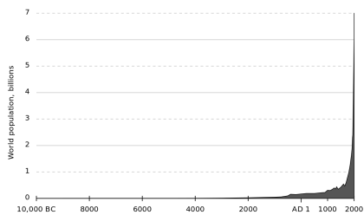
World population (2018) ~7.6 billion
(Superexponential growth)
World population, billions
Notes:
Unlike exponential growth, where the curve looks the same at every point, superexponential growth has one or more “knees” in the curve, places where growth suddenly switches from a slower to an even faster (or sometimes slower) exponential mode.
called “Hockey Stick” or J-curve growth, as, like a capital J, there is a period of low growth, a knee of the curve, and then a period where growth goes almost vertical for a time.

Slide 8
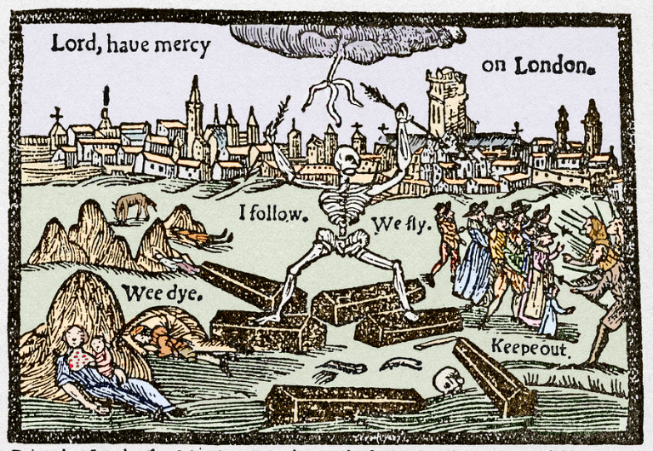
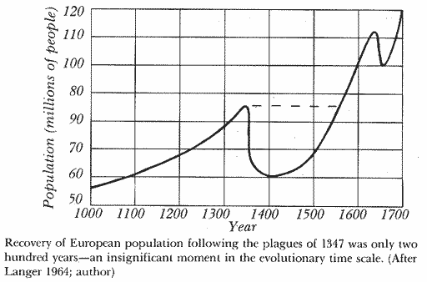
Nearing modern time
Pre-19th century growth rates were ~0.2%/yr
<1 billion
?
After this time, began to rise faster
Notes:
What is this event?
1348 plague – in 2 years, ¼ to 1/3 of Europe died, some cities by ½
After these plagues, rose faster (nutrition and hygiene)
Now why am I showing you this time period? This is the HOOK of the j-curve – after 1700, population growth rate increases dramatically. After the plague, pop DOUBLED from 60 to 120 million in 300 years.

Slide 9
Recently
1800 → 1 billion
1930 → 2 billion
1975 → 4 billion
2018 → 7.6 Billion
Notes:
And it hit 1 billion for the first time in 1800.
130 years to double
45 years to double
43 years – has nearly doubled again

Slide 10
Activity – population pyramids
ASSIGNED BY LAST NAME
A-B → 1955
C-G → 1970
H-M → 1985
N-R → 2000
S-Z → 2015

Slide 11
Discussion
What is the shape of your pyramid
What does your pyramid tell you about population growth rate?
How do pop. Pyramids change over time?
Based on this data, predict how population growth rate has changed over time?

Slide 12
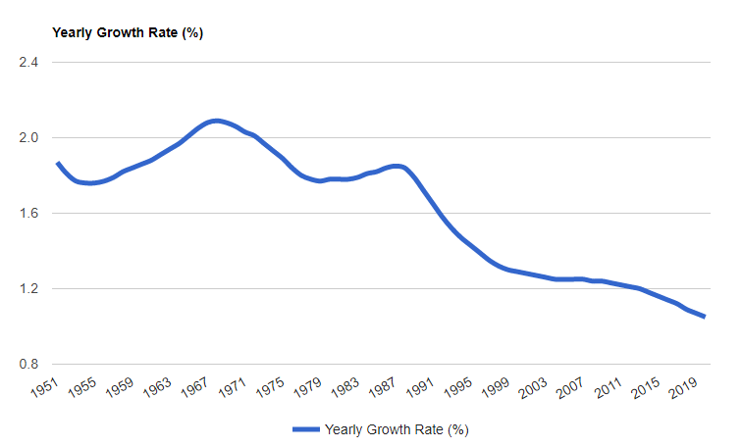
Peak rate in 1960’s = 2.1%/yr
By 1980’s, slowed to 1.8%/yr
By 2000, slowed to 1.3%/yr
By 2013, slowed to 1.2%/yr
By 2018, slowed to 1.1%

Slide 13
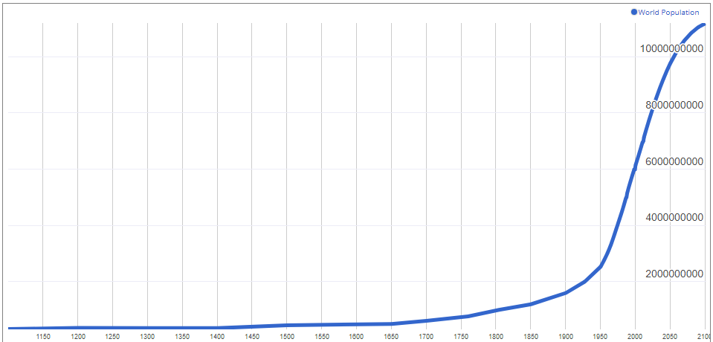
World population
Today

Slide 14
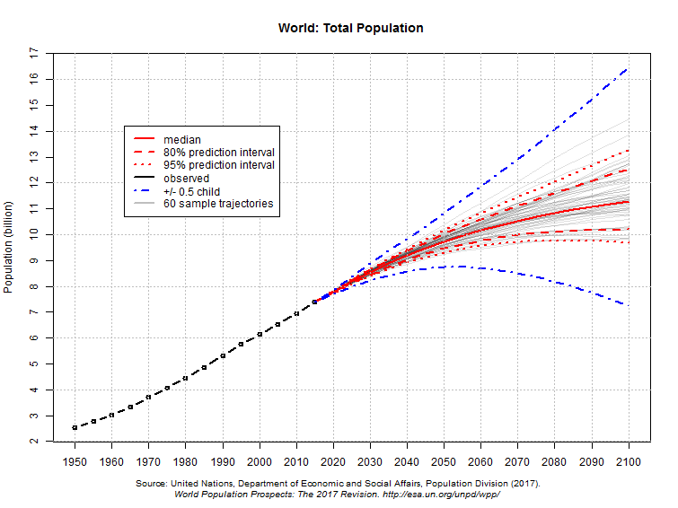
Future predictions
The World Population Prospects: The 2017 Revision, published by the UN Department of Economic and Social Affairs predicts:
8.6 billion by 2030
9.8 billion by 2050
11.2 billion in 2100
Level off at 12 billion?
Notes:
Predicted to eventually level off… sometime after 2100, at around 12 billion people
World population projected to reach 9.7 billion by 2050. The current world population of 7.6 billion is expected to reach 8.5 billion by 2030, 9.7 billion in 2050 and 11.2 billion in 2100, according to a new UN DESA report, “World PopulationProspects: The 2015 Revision”, launched today .Jul 29, 2015

Slide 15
What causes population growth rate to change?
Notes:
Open ended discussion – try to relate things back to the pyramids

Slide 16
CHALLENGE – can that many people lead decent lives on this planet?
Social and political
SCIENCE AND ENGINEERING
Exploit and fairly divide resources
Without wrecking the planet
Notes:
Tempting to want to stick with past methods… just can’t though – growing too fast

Slide 17
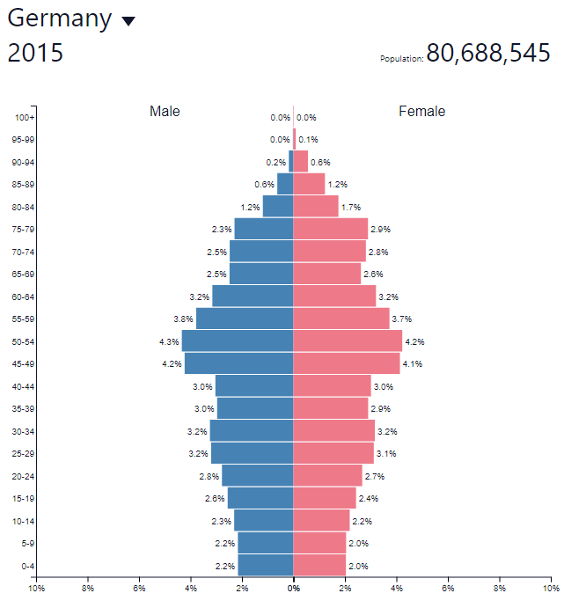
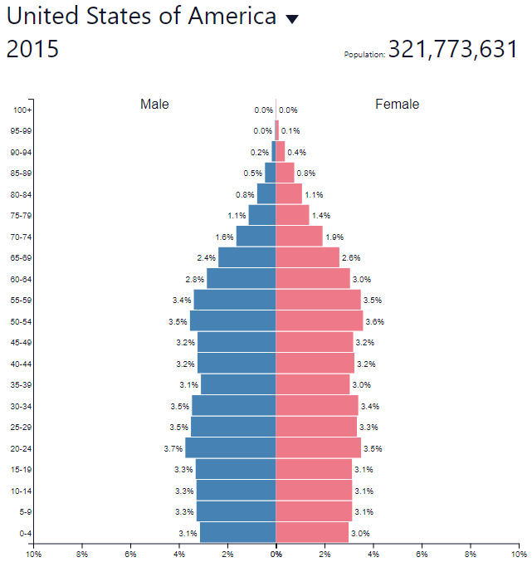
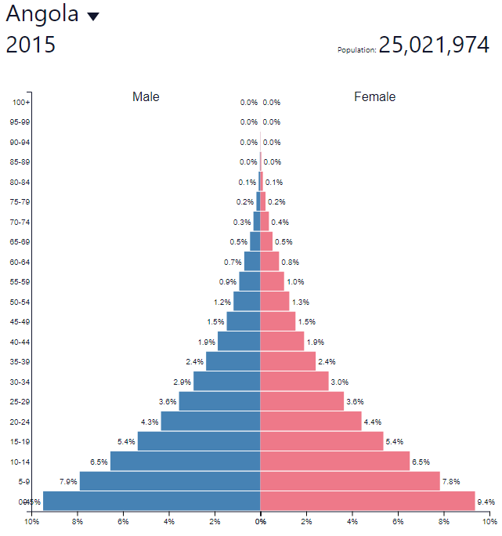

Slide 18
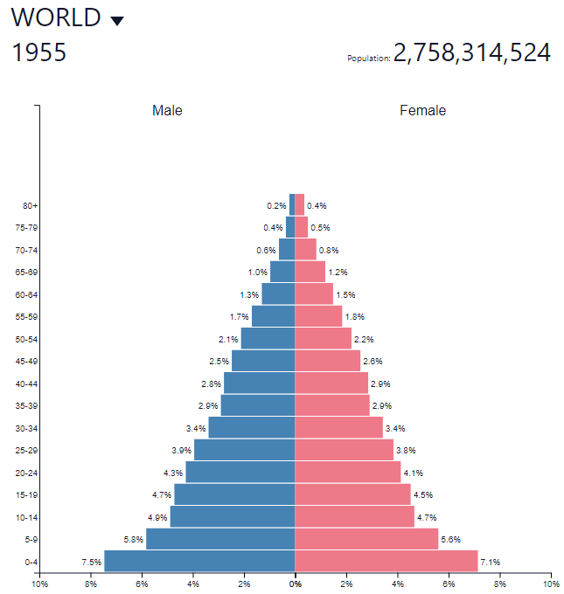
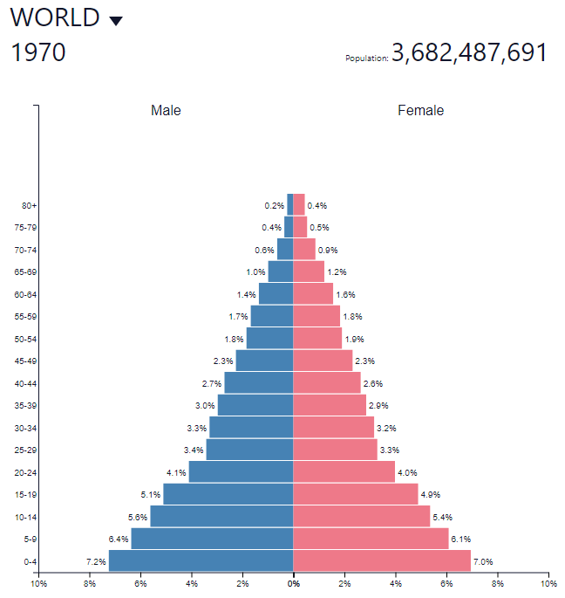

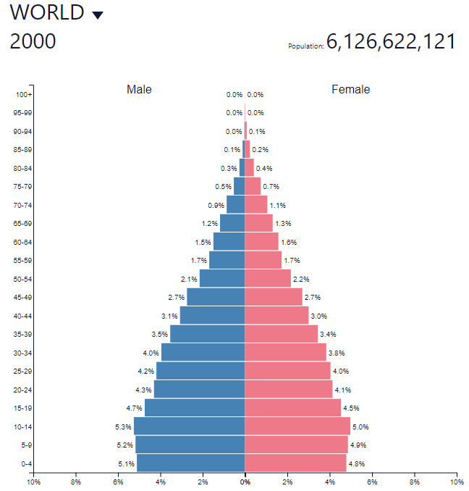
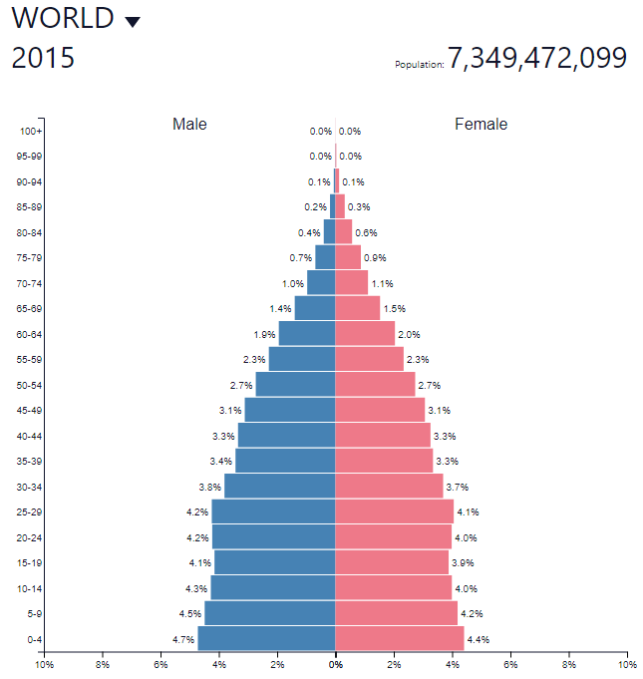
1955
1970
1985
2000
2015
Notes:
Based on these population pyramids, how do you think the rate of global population growth has changed?
Has population continued to increase over this period? Decrease?

